Slide 1

CSC 4227 Digital Image Processing
Lecture 18 – Image Restoration : Noise Removal
Dr. Kazi A Kalpoma
Professor, Department of CSE
& Director of ICT
Ahsanullah University of Science & Technology (AUST)
Contact: kalpoma@aust.com
Google Class code: xdjixk3
CSE | AUST
Spring 2022
Notes:
kalpoma@gmail.com

Slide 2
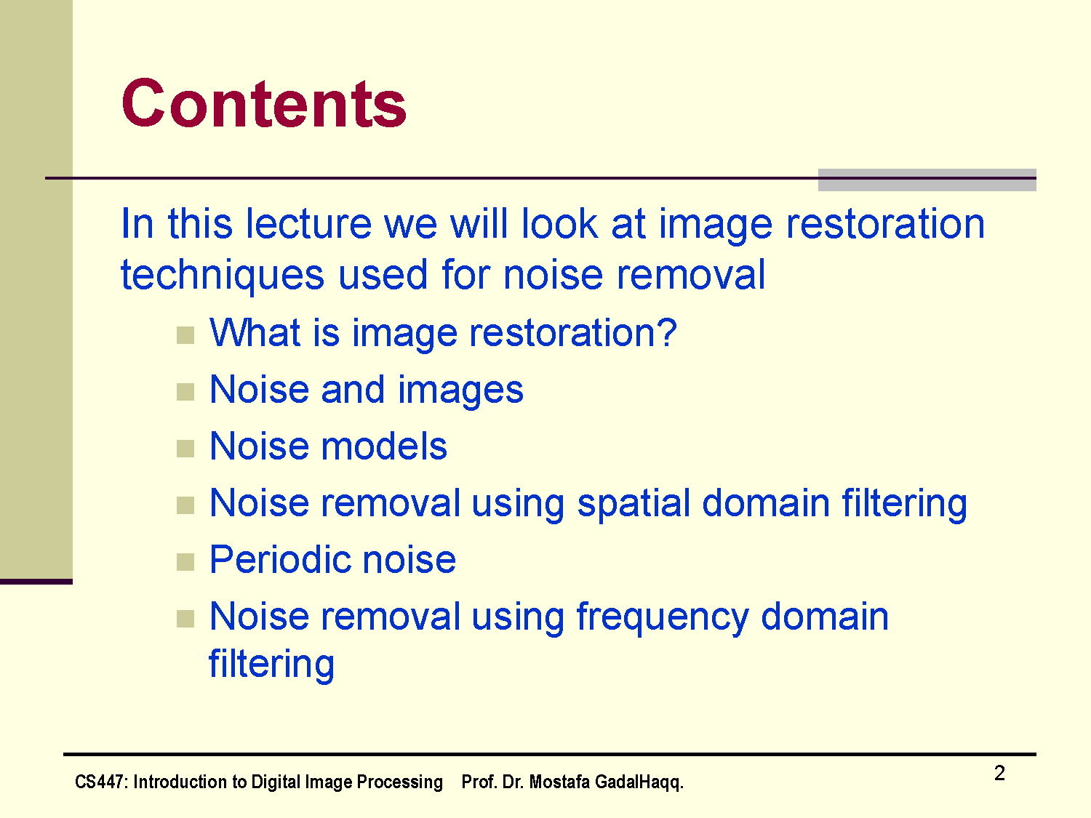
The PPT is designed with the help of different materials of other authors.

Slide 3
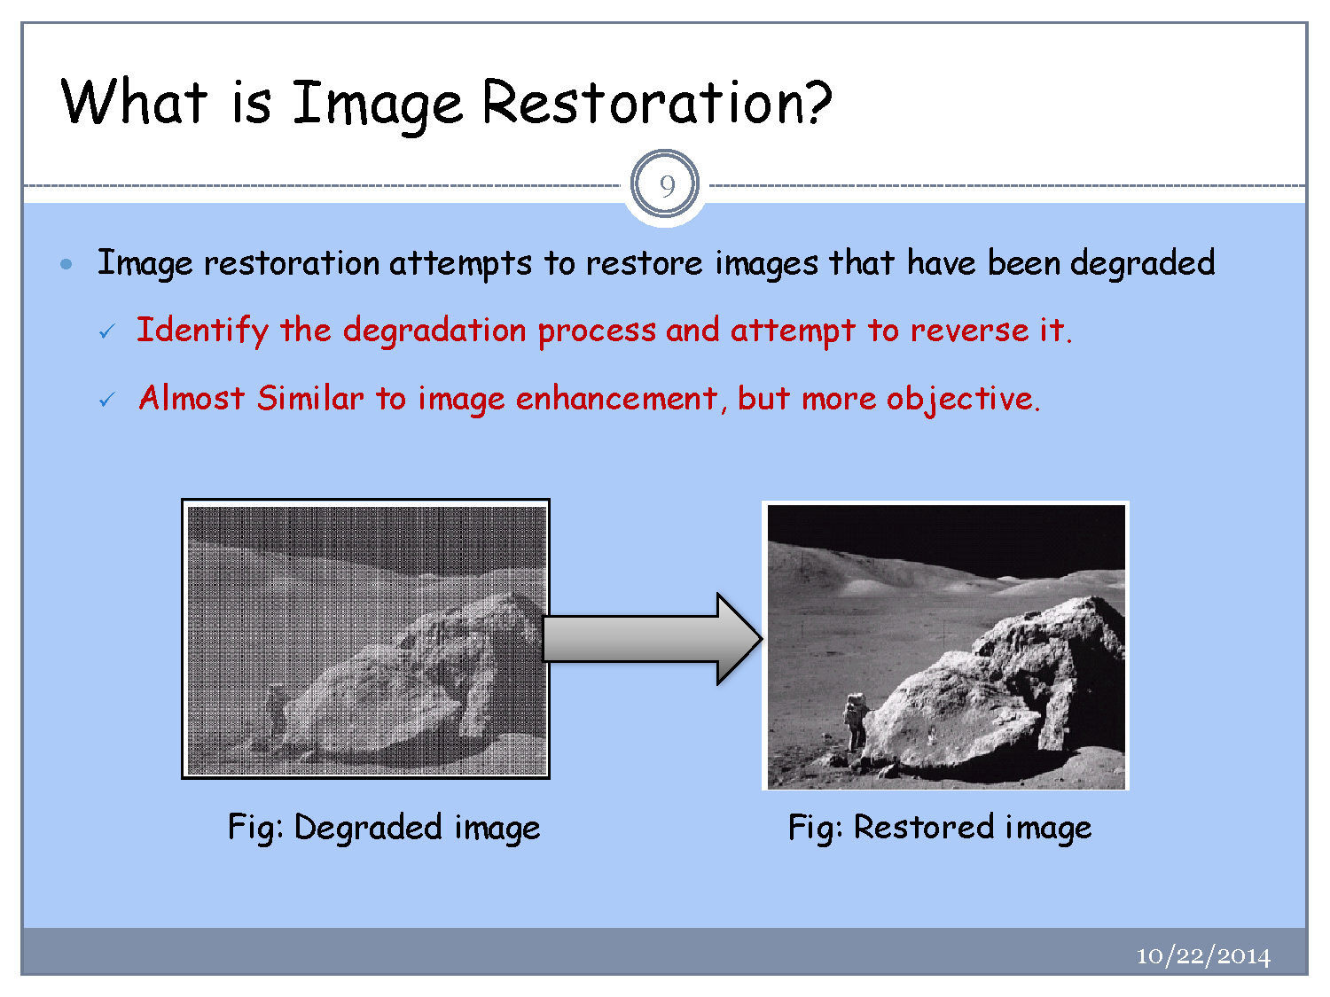

Slide 4
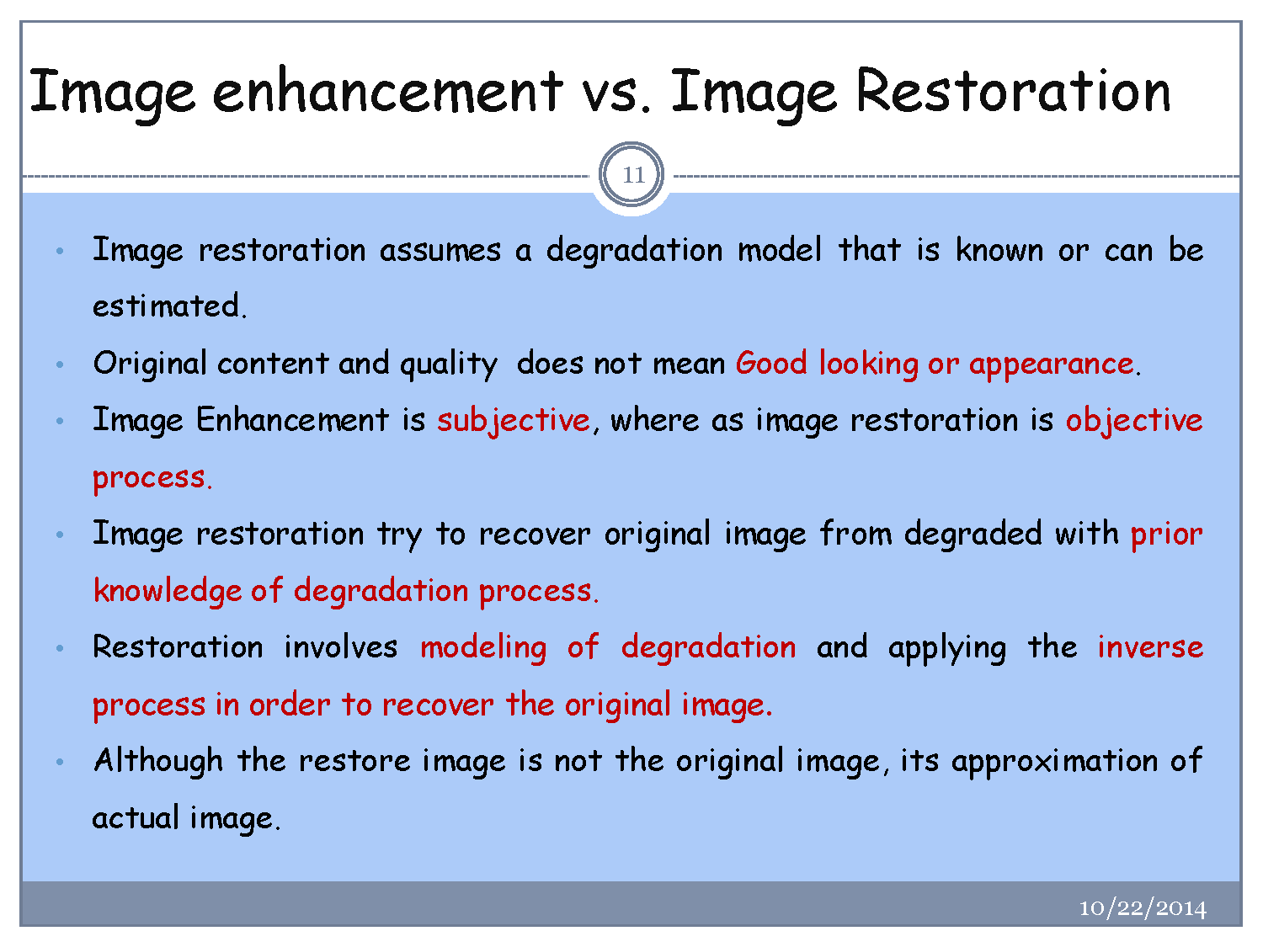

Slide 5
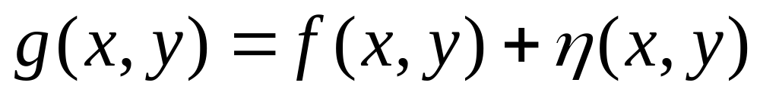
Noise Model
We can consider a noisy image to be modelled as follows:
where f(x, y) is the original image pixel, η(x, y) is the noise term and g(x, y) is the resulting noisy pixel
If we can estimate the model the noise in an image is based on this will help us to figure out how to restore the image

Slide 6
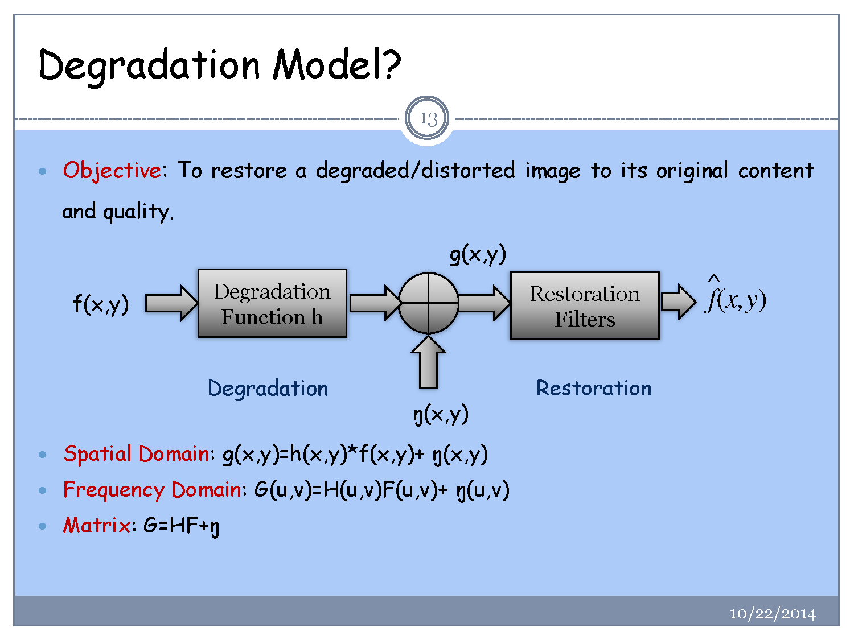

Slide 7
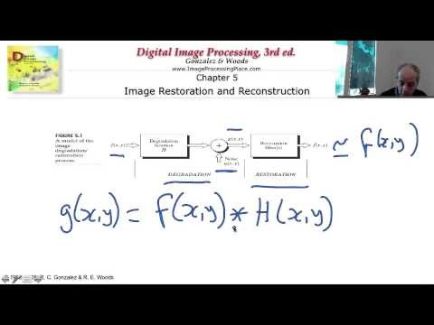
What is Image Restoration
https://www.youtube.com/watch?v=AHOV4507GBQ

Slide 8
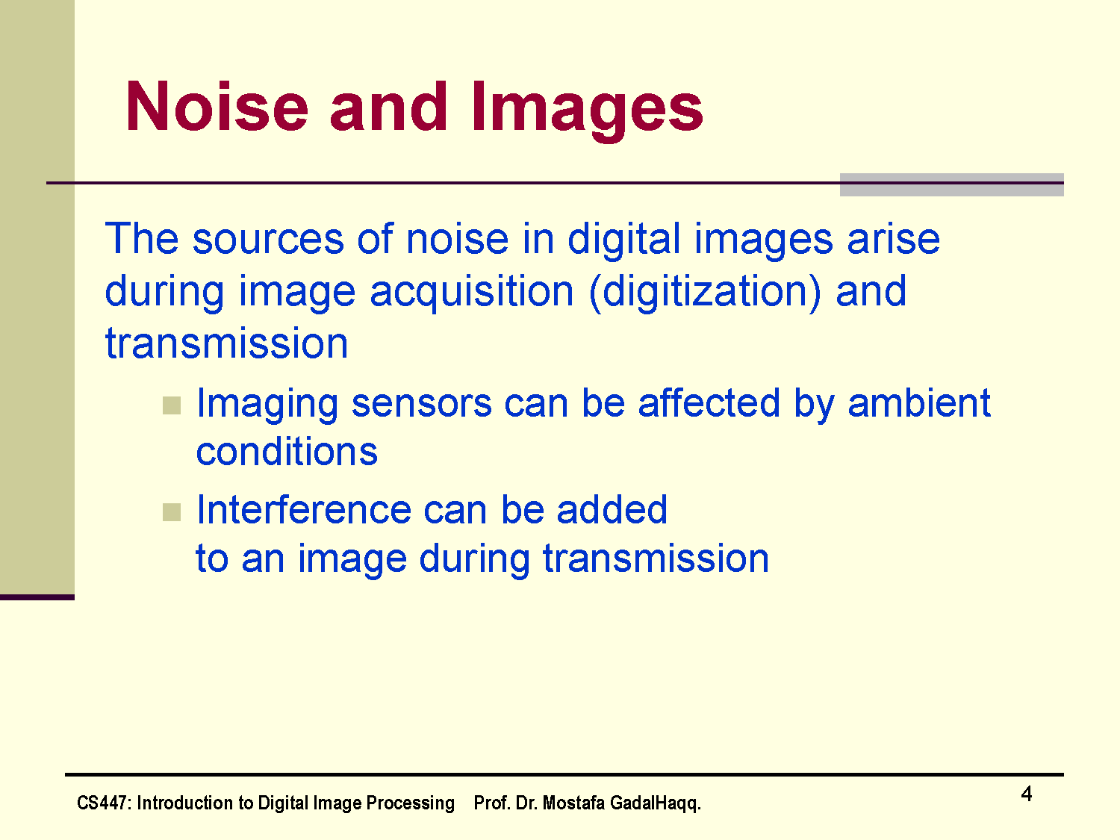
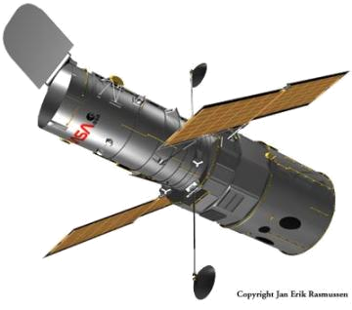
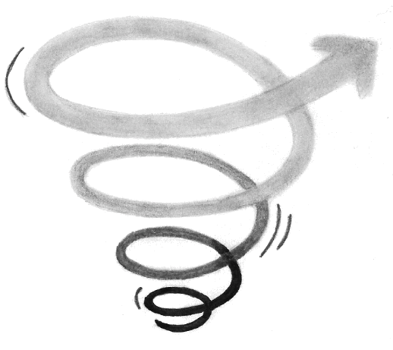

The sources of noise in digital images arise during image acquisition (digitization) and transmission
  Imaging sensors can be affected by ambient conditions
  Interference can be added
  to an image during transmission

Slide 9
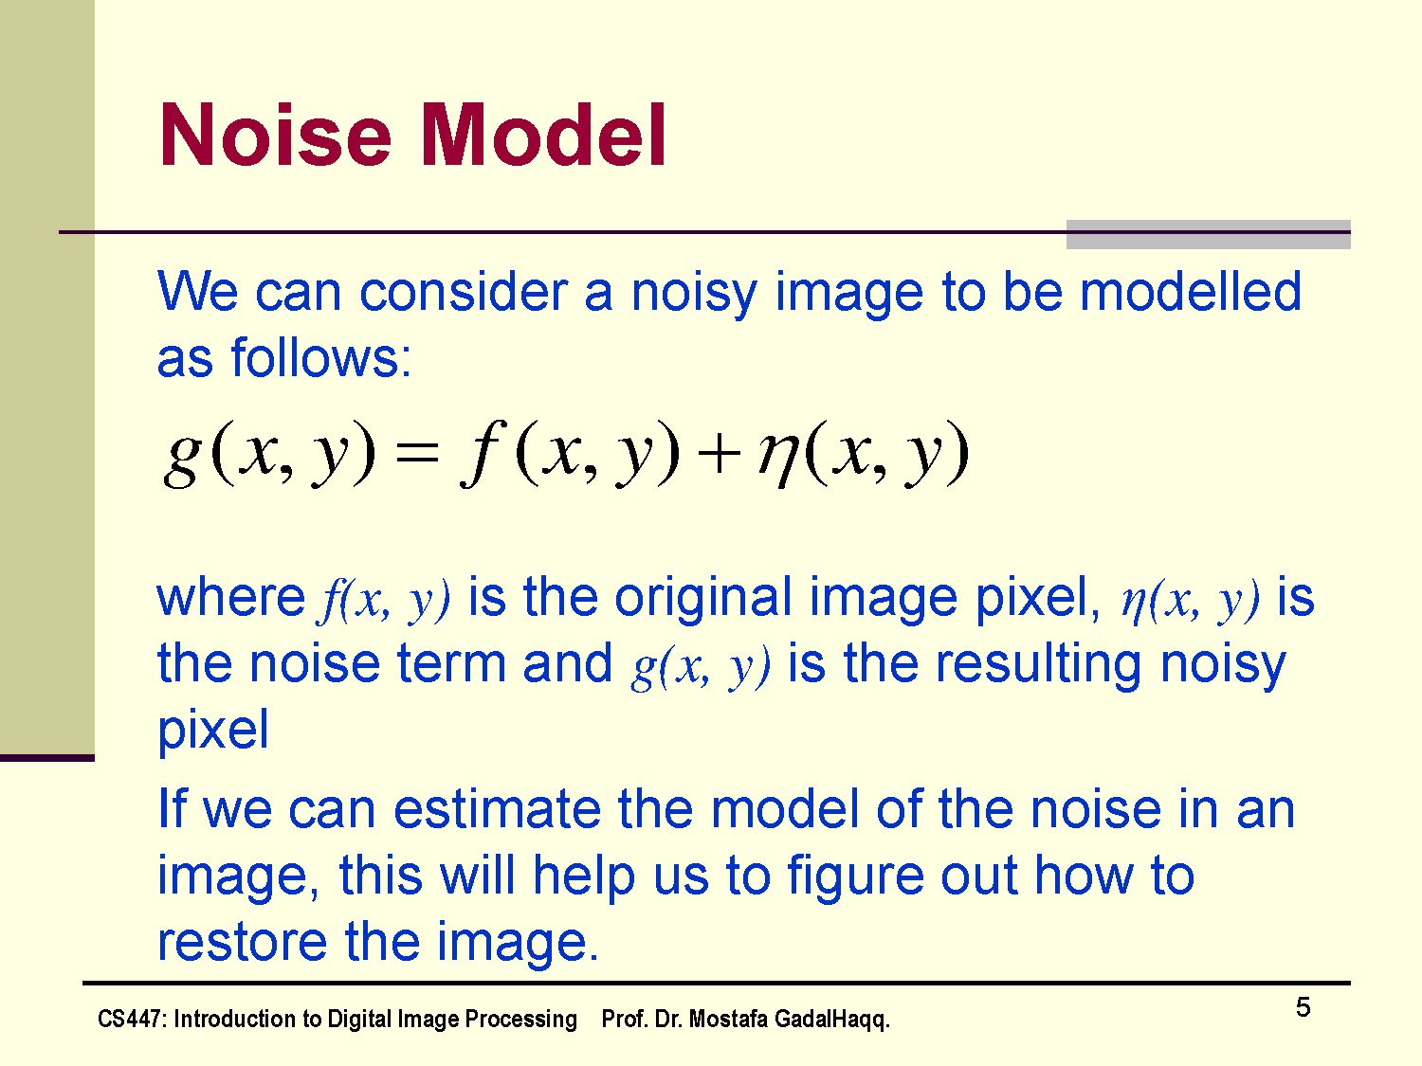

Slide 10
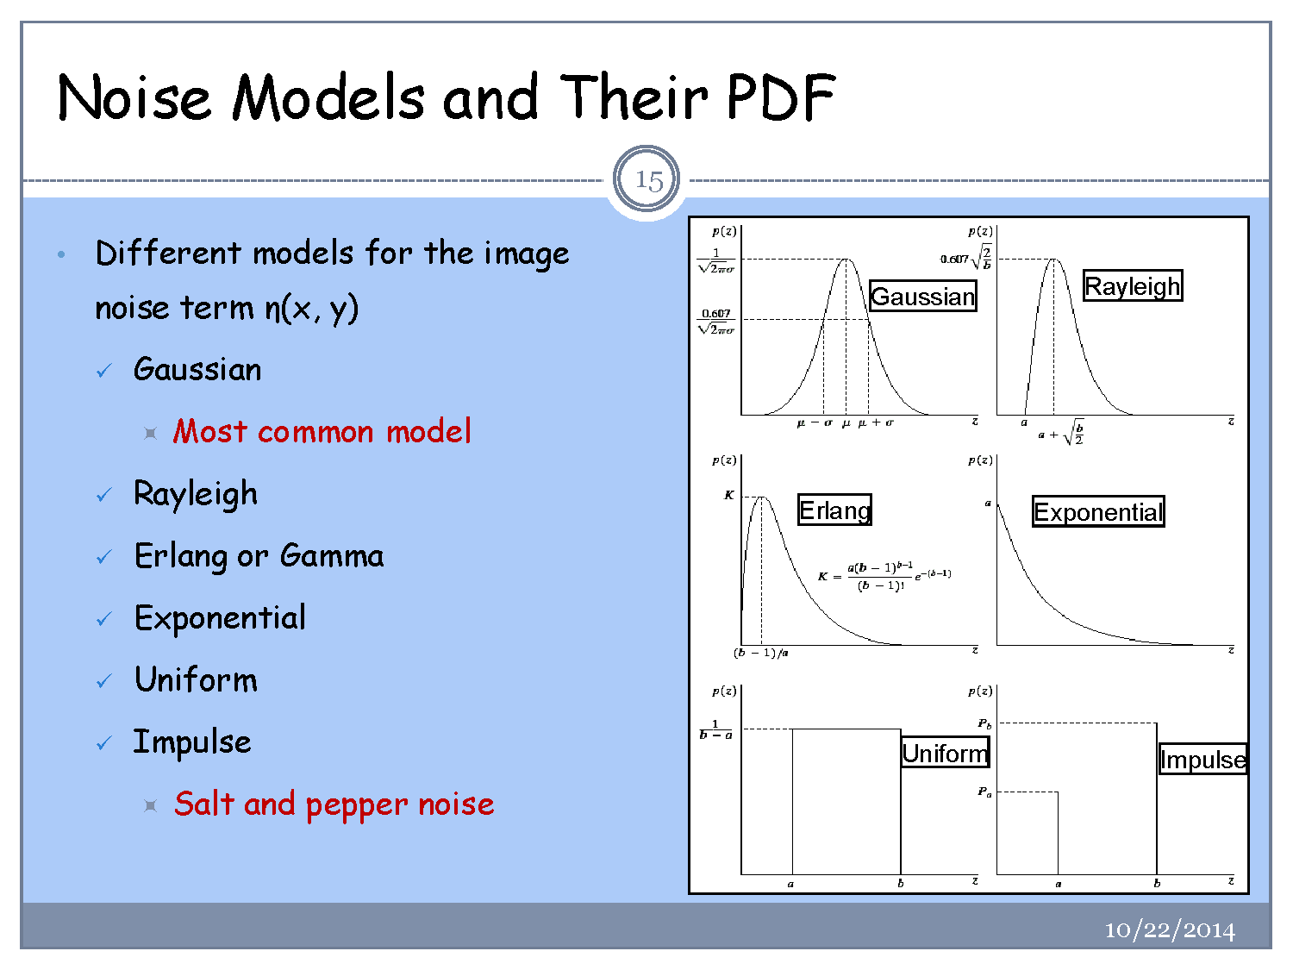

Slide 11
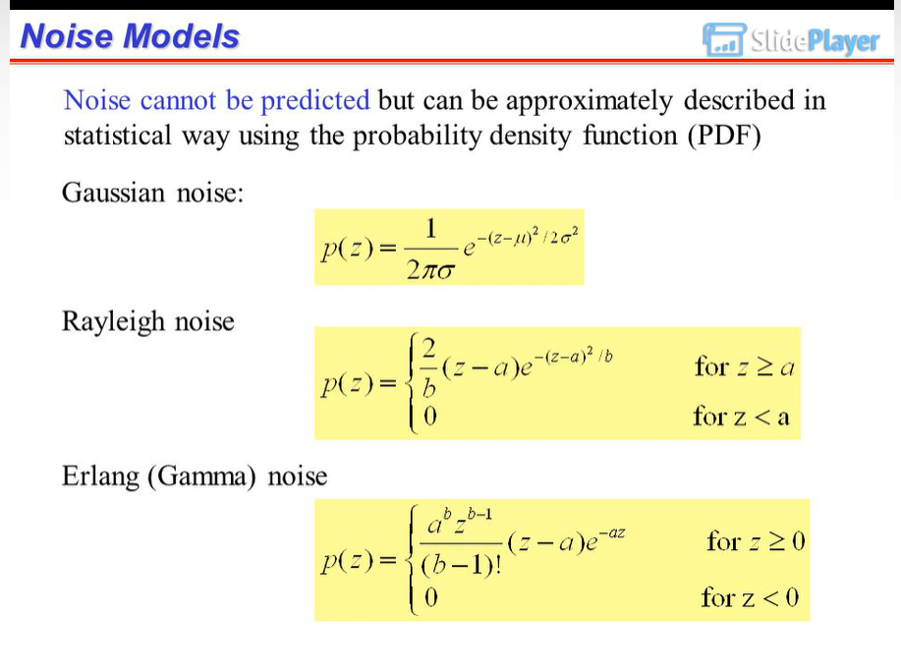

Slide 12
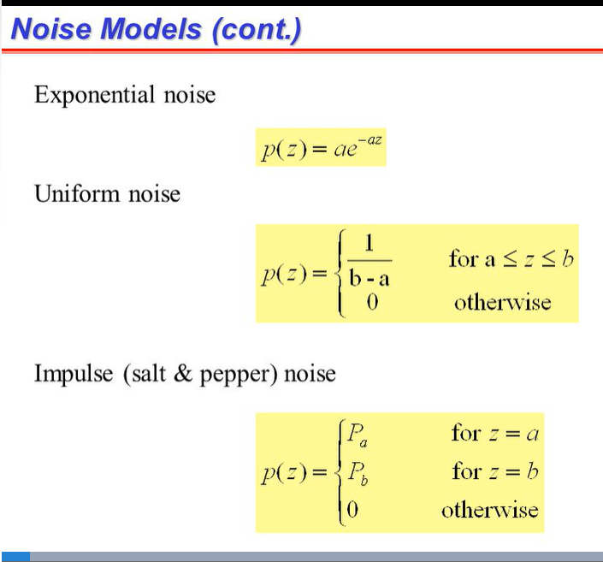

Slide 13
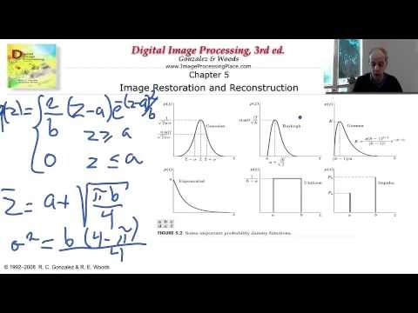
Noise Types (optional to watch)
https://www.youtube.com/watch?v=vZNyZgdEhgQ

Slide 14
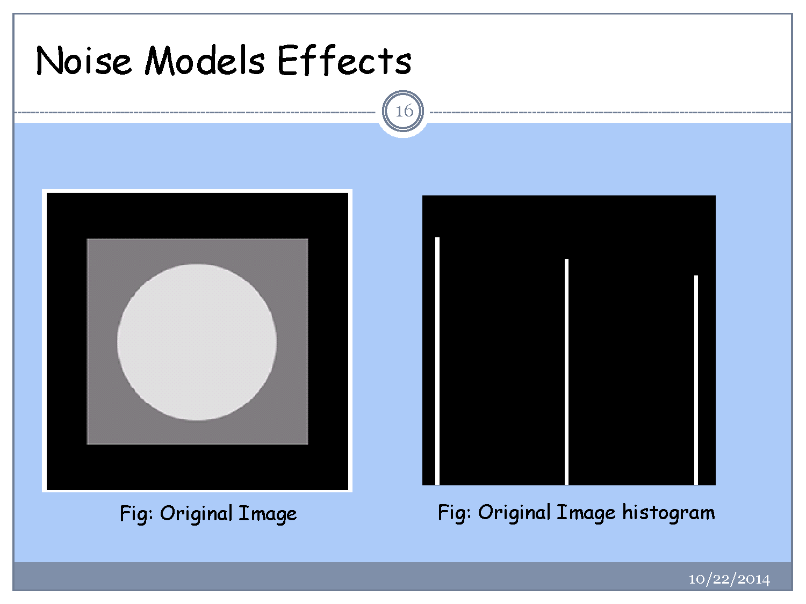

Slide 15
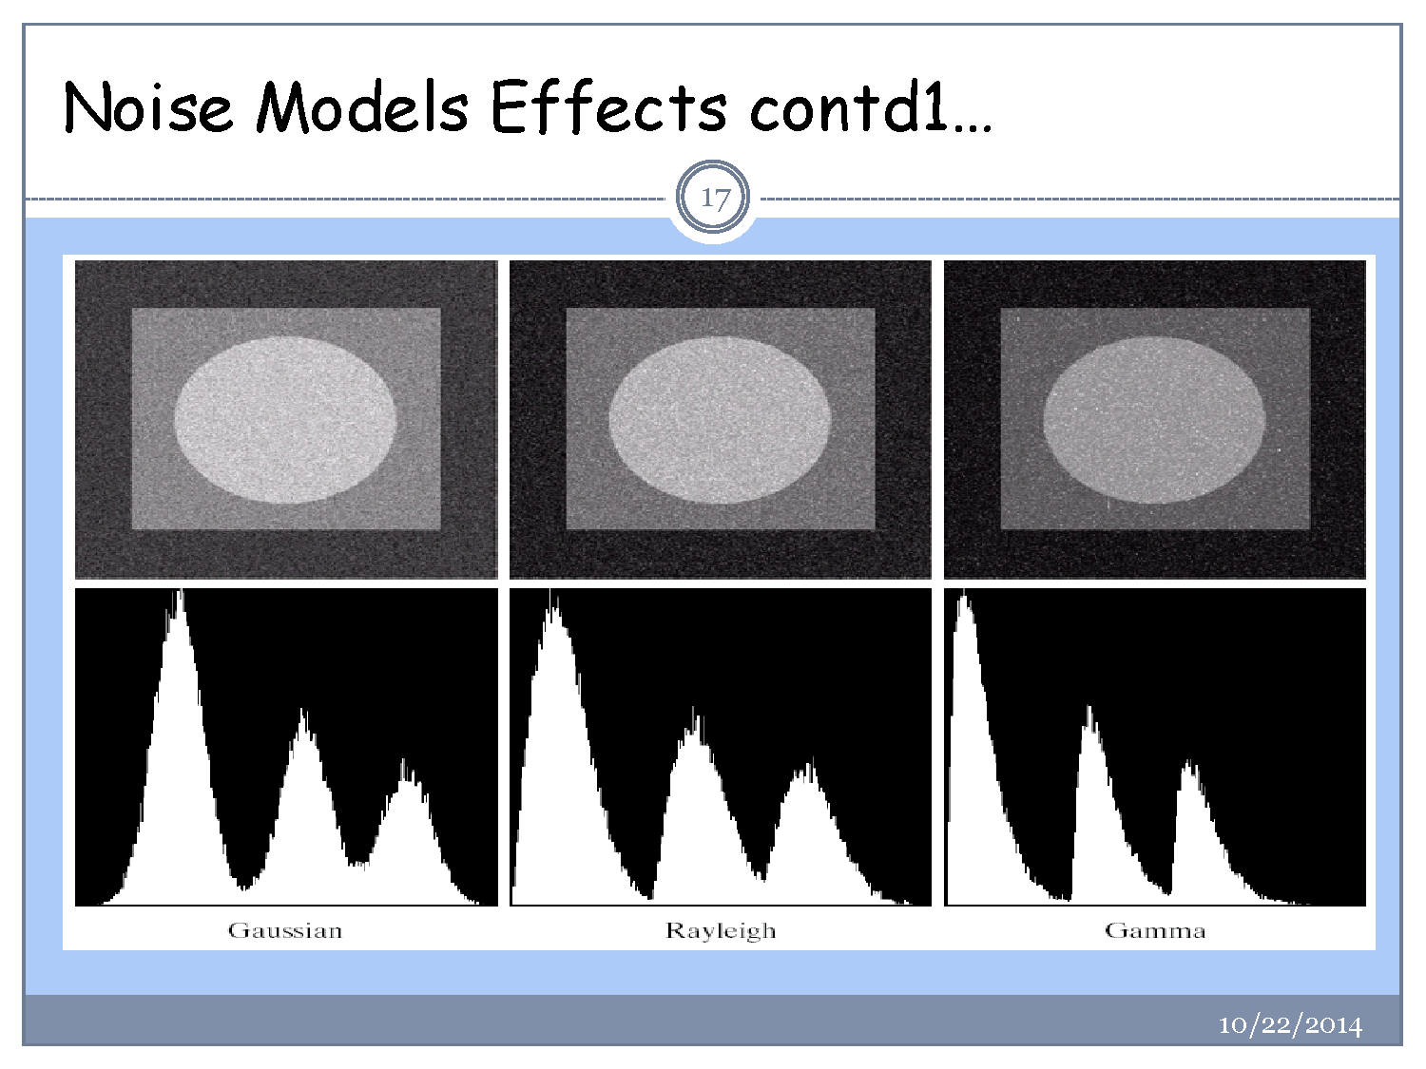

Slide 16
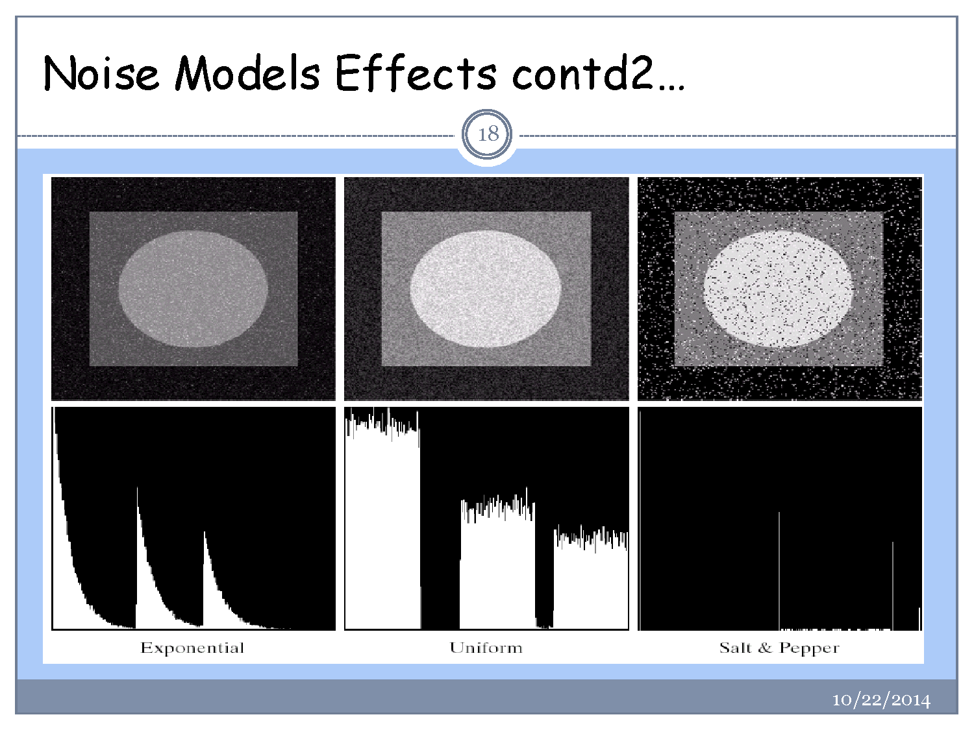

Slide 17
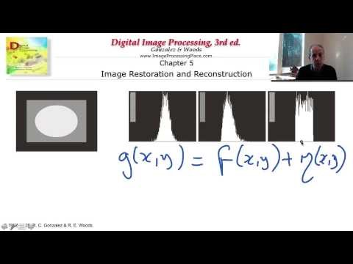
Estimating noise
https://www.youtube.com/watch?v=CIa60r2E2VI

Slide 18
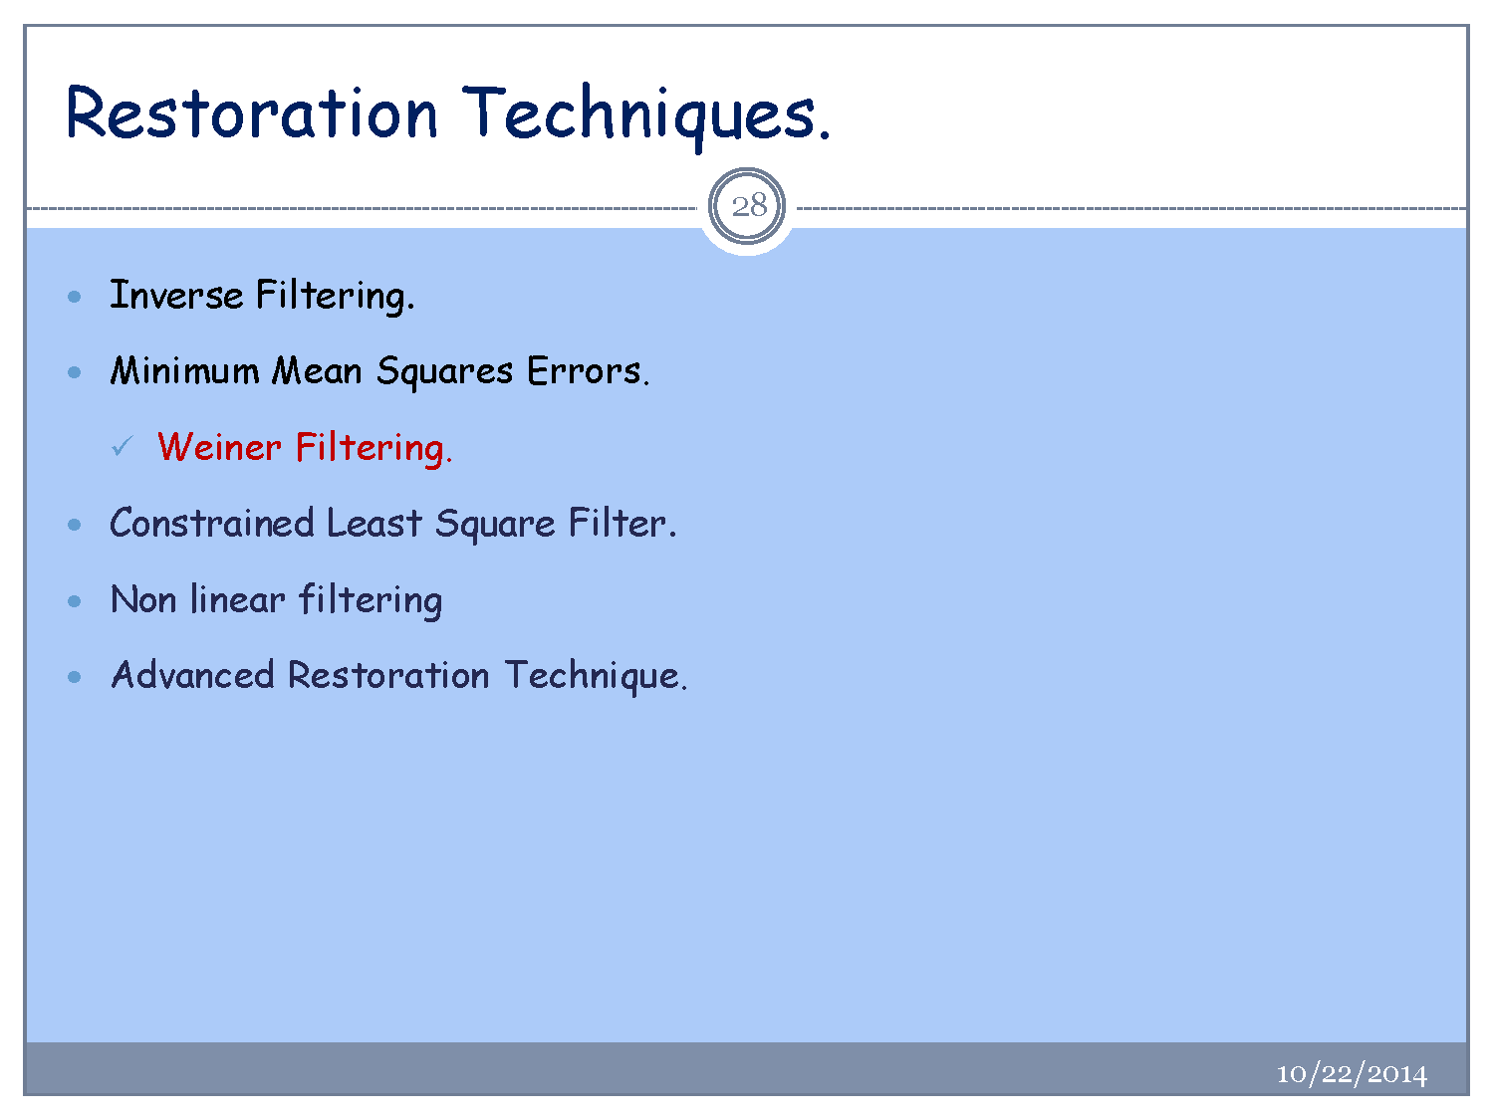

Slide 19
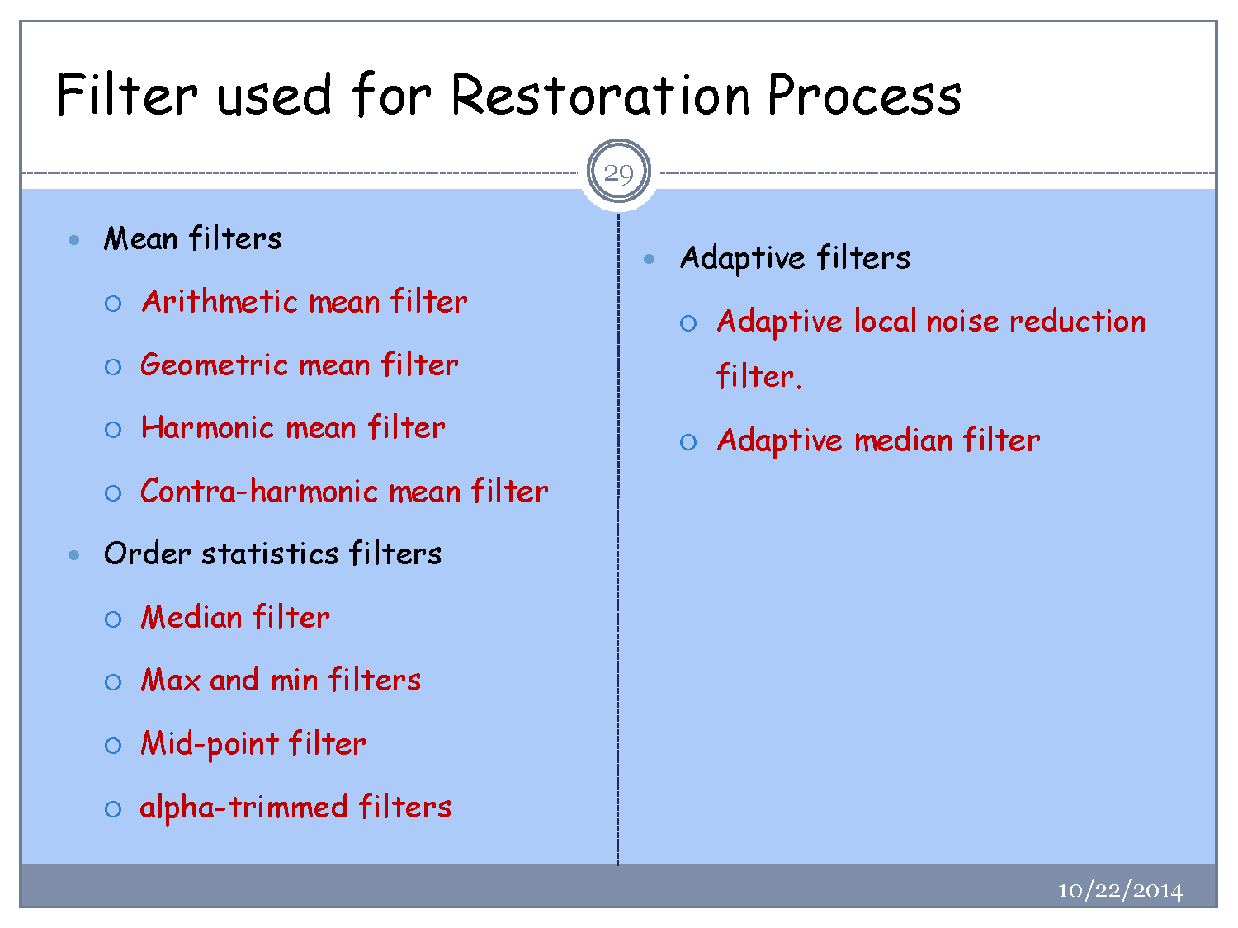

Slide 20
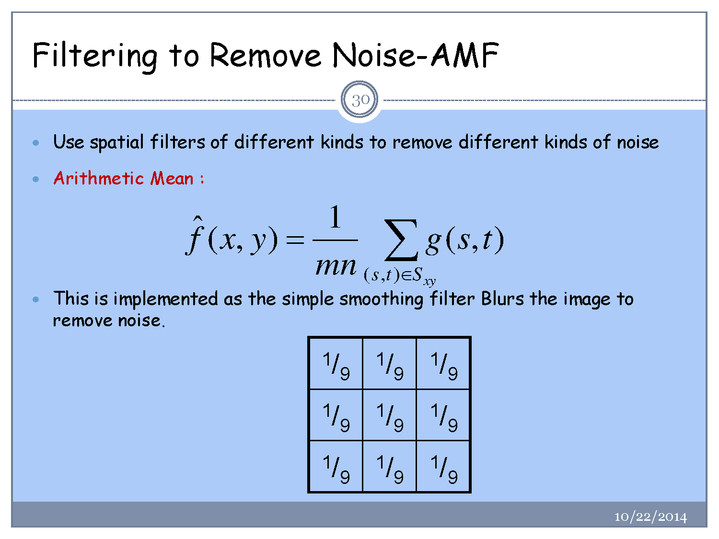

Slide 21
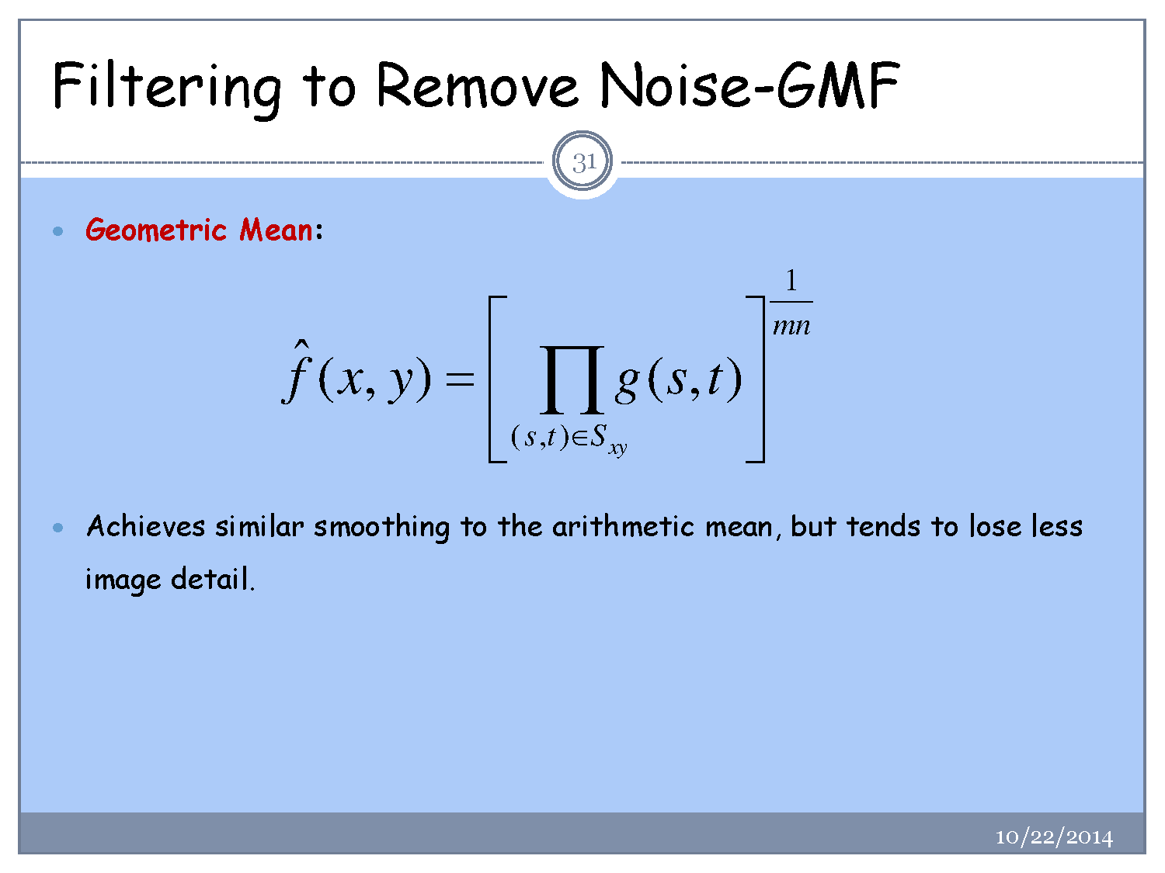

Slide 22
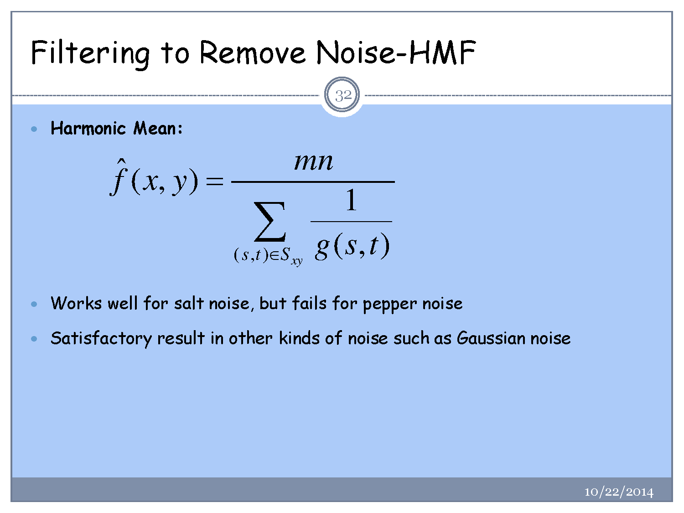

Slide 23
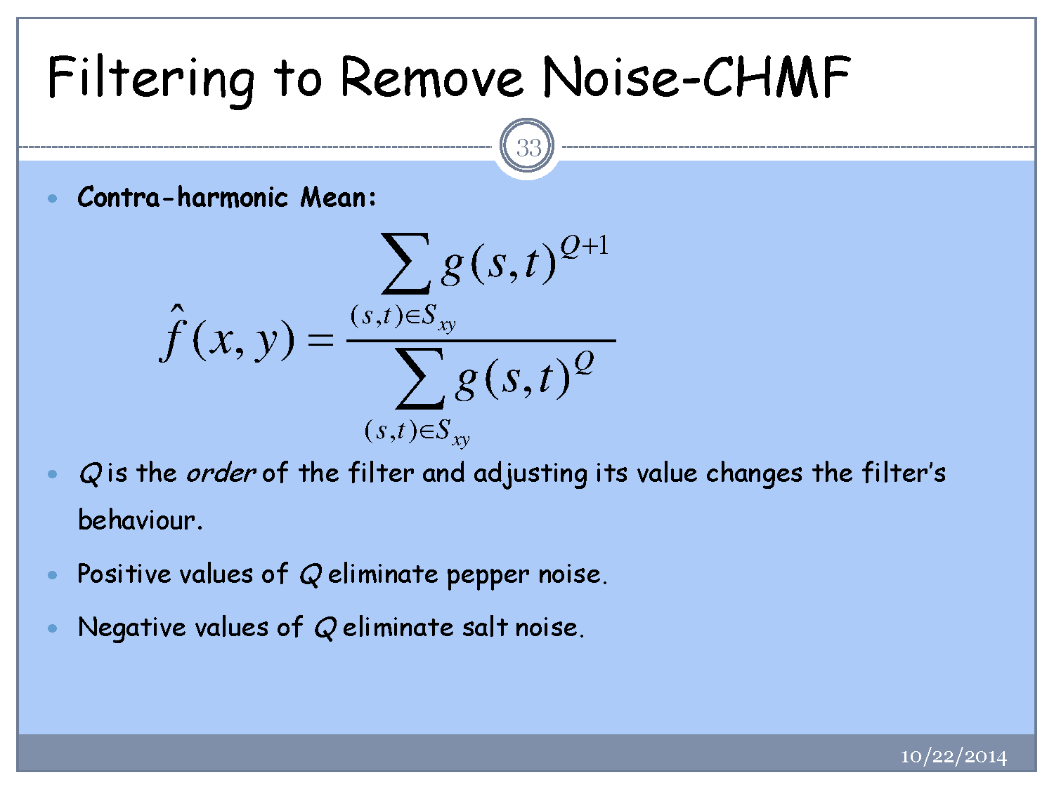

Slide 24
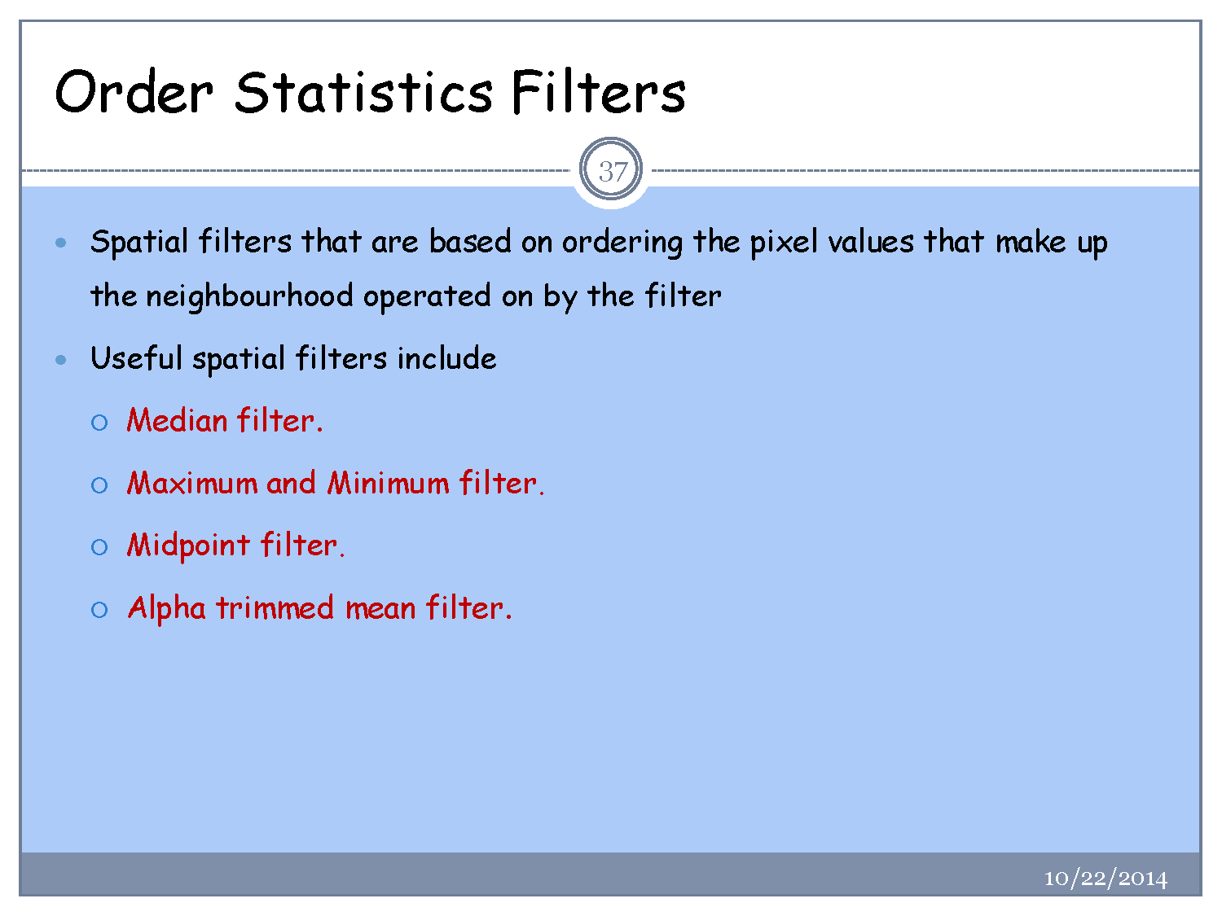

Slide 25
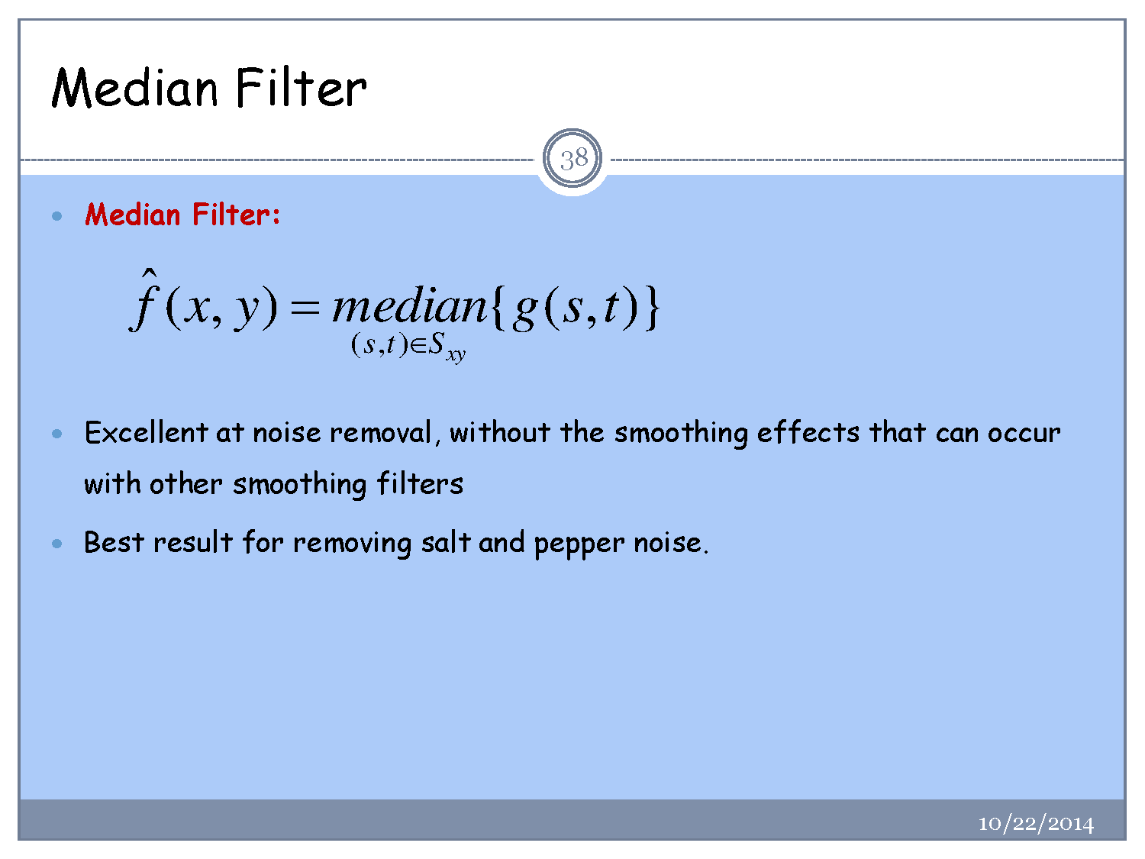

Slide 26
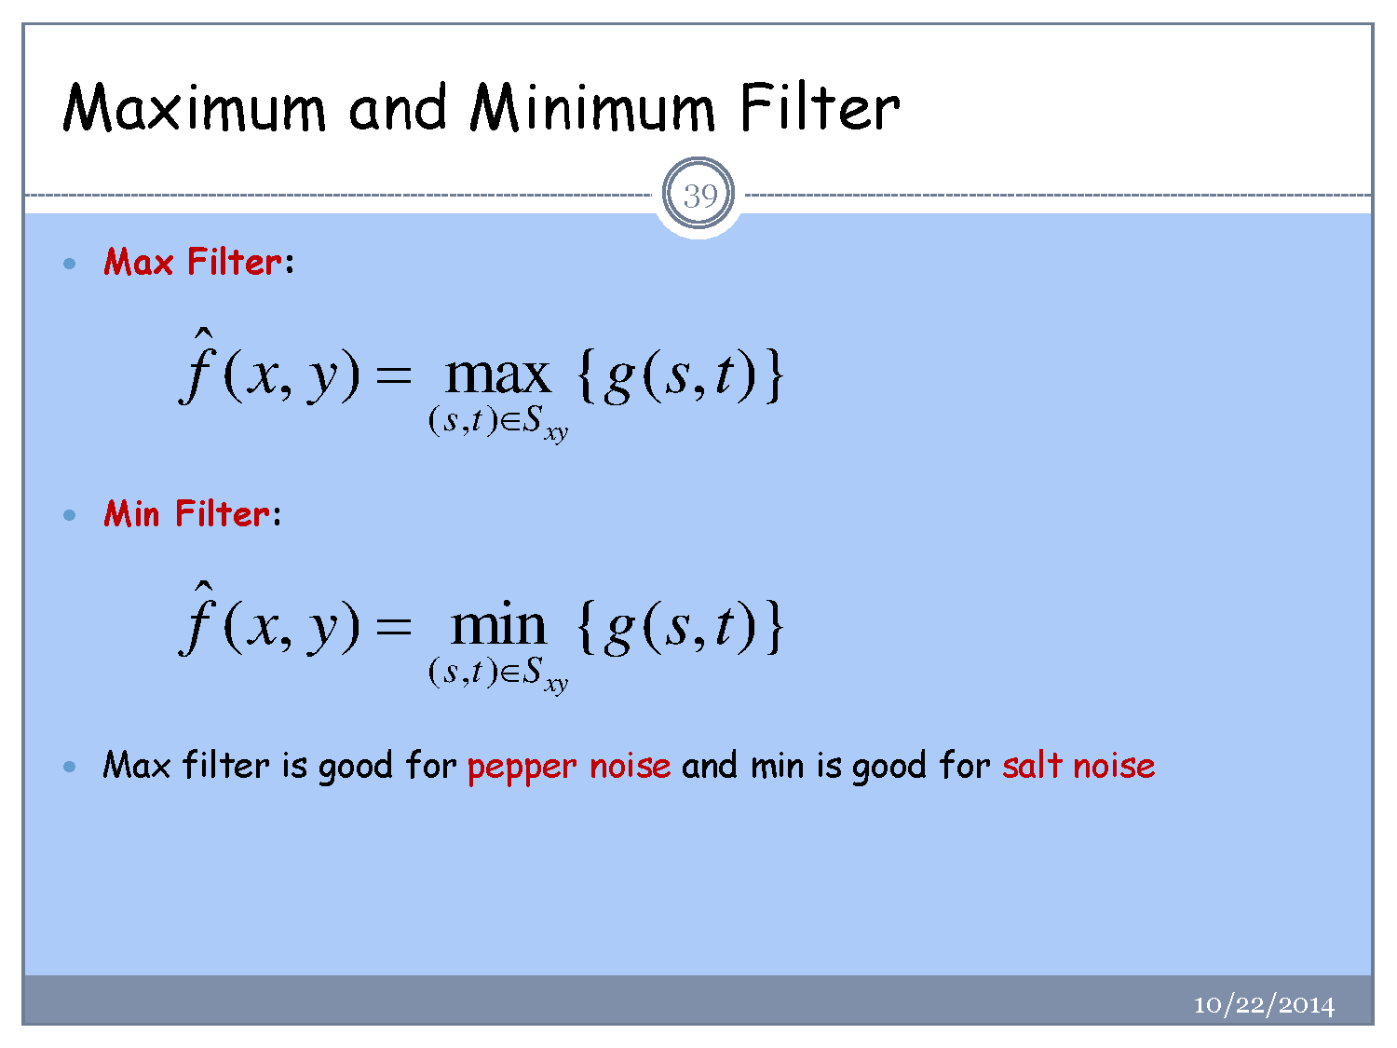

Slide 27
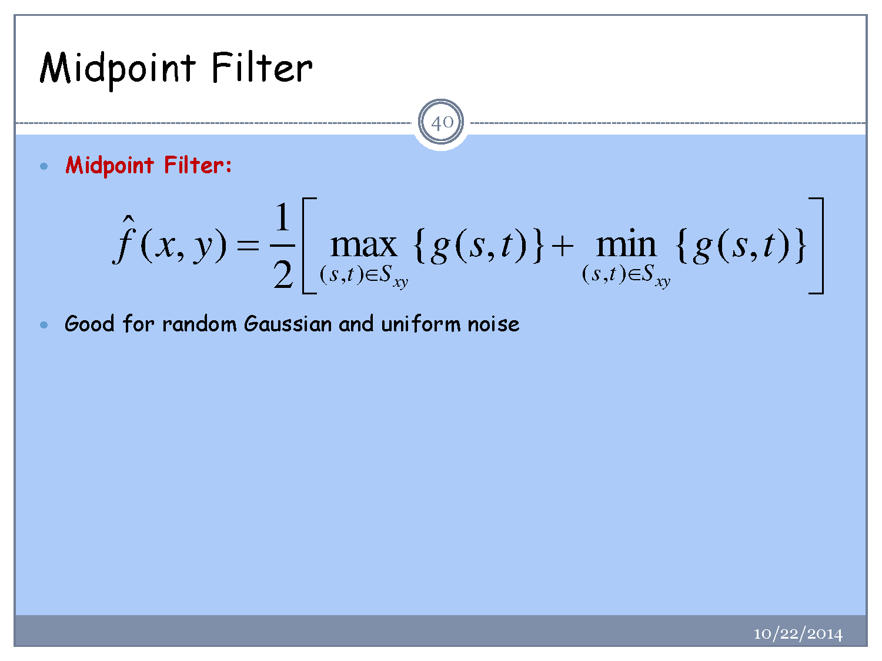

Slide 28
